Slide 1
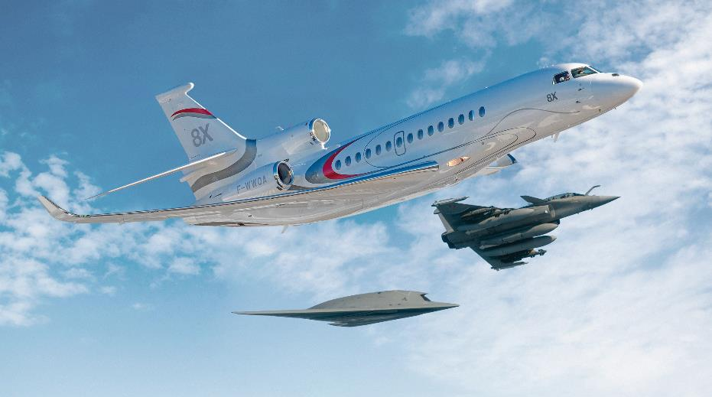



2020公务与通用航空高峰论坛
Business Aviation & General Aviation International Summit
2020年10月23日 / Oct 23th 2020

Slide 2
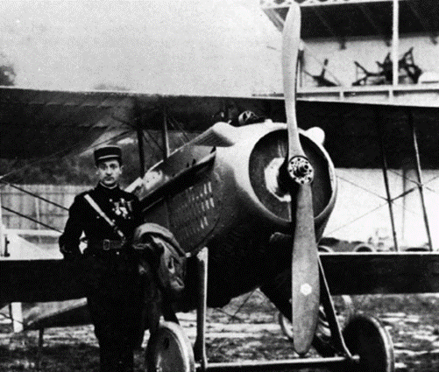
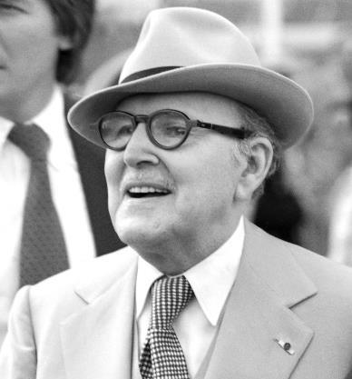
Éclair 螺旋桨
马塞尔 · 达索
达索航空 The Corporation
自1915年发明 Éclair 螺旋桨以来，达索飞机展现出卓越的科技创新能力
超过 60 年在民用和军用飞机领域的经验和专业技术积淀
Since the invention of the Éclair propeller in 1915, Dassault aircraft have demonstrated a technological excellence
Dassault Aviation has over 60 years of experience and expertise in both civil and military aircraft.

Slide 3
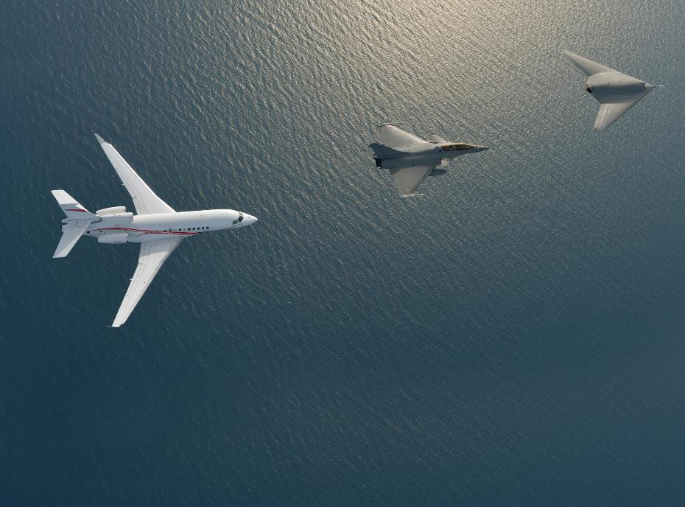
达索航空 – 介绍 Dassault Aviation - Introduction
民用和军用航空的双领域专家
Dual expertise: Civilian and Military
设计了 100 多种原型机 Dassault Aviation designed more than 100 prototypes
生产了超过 10,000 架飞机，包括世界闻名的阵风战斗机、幻影战斗机和猎 鹰公务机
More than 10,000 aircraft manufactured including world-famous Rafale, Mirage and Falcon
欧洲无人战斗机计划和未来欧洲军事隐形战斗机领导者
Dassault Aviation, the European leader in UCAV (Unmanned Combat Air Vehicle) programs and Future European military stealth fighter (FCAS)
猎鹰 7X 和阵风战斗机比肩飞行
© Dassault Aviation - K. Tokunaga

Slide 4
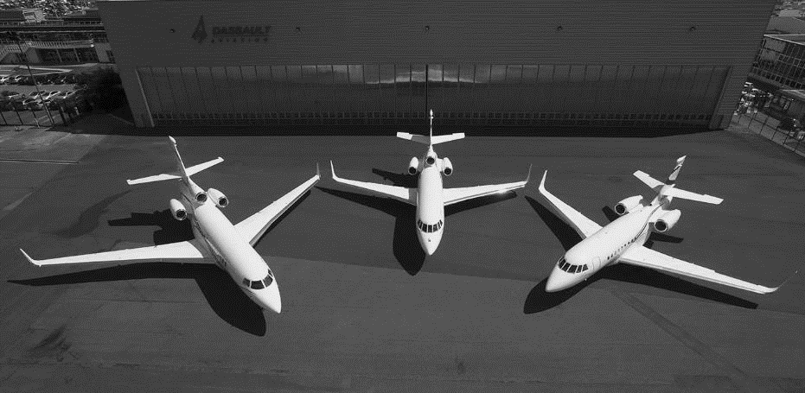


什么是公务航空？What is Business Aviation?
飞机到达的地点需要尽可能靠近办公室、工厂等任何目的地
Aircraft need to reach any destinations as closed as possible to offices, factories…
飞机在任何条件下都起飞和降落……安全第一
Land and take off under any conditions… SAFETY IS FIRST
客户：成功的企业家，政府要员和管理公司
Customers: Successful Entrepreneurs, Corporations, Government and Management company
高联通性让企业家与世界保持连接
High connectivity allowing Entrepreneurs to remain connected with the World
公务机是空中办公室，是真正的商务工具
Business Jets is a flying office, IT IS NOT A TOY BUT A TOOL

Slide 5
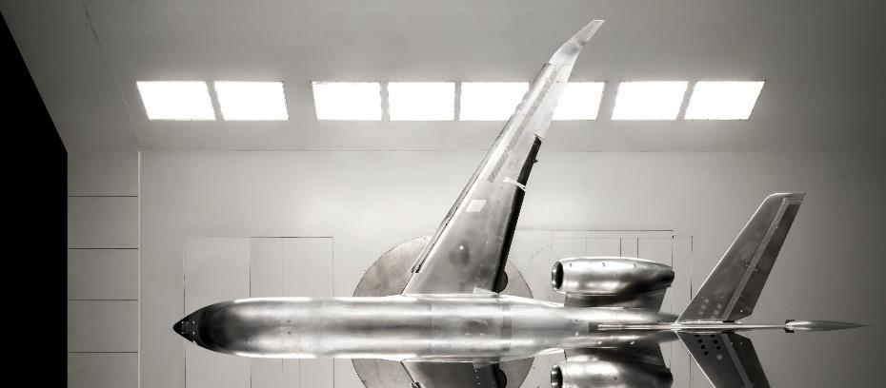
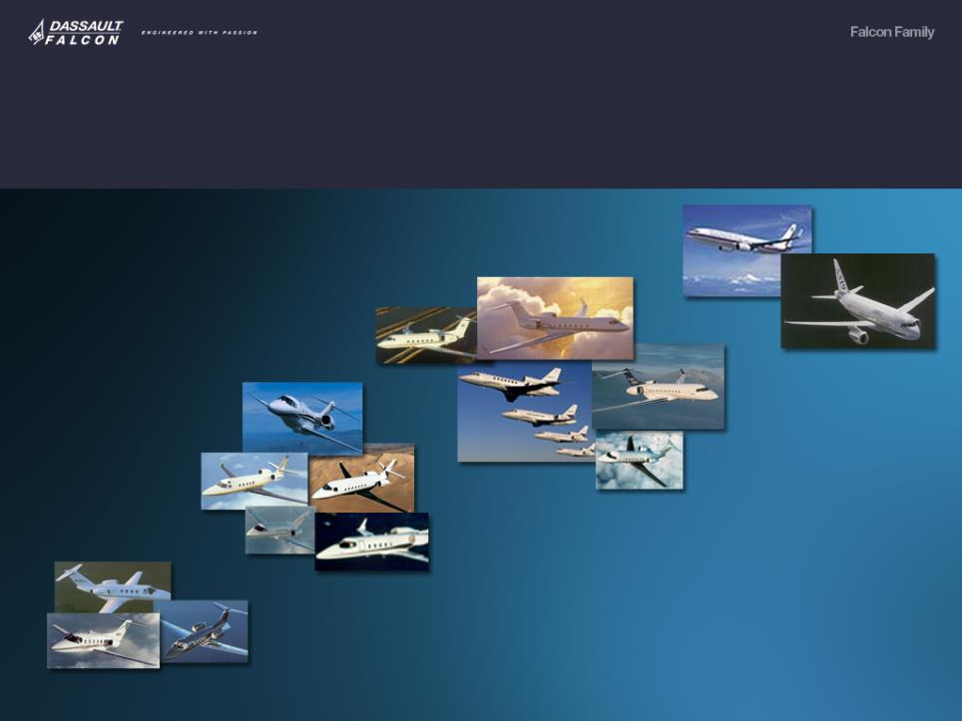
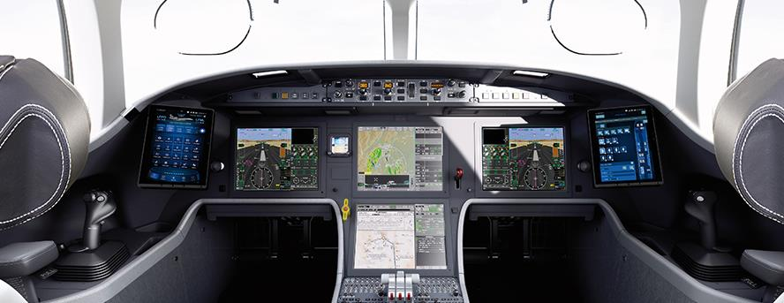
不同的市场定位 Different Segment
巨型机 Huge Jet
3 % 交付量 Delivery
7 % 营业额 Sales
大型机 Large-size Jet
中型机 Mid-size Jet
40 % 交付量 Delivery
17 % 交付量 Delivery
68 % 营业额 Sales
13 % 营业额 Sales
轻型机 Small-size Jet
40 % 交付量 Delivery
12 % 营业额 Sales

Slide 6
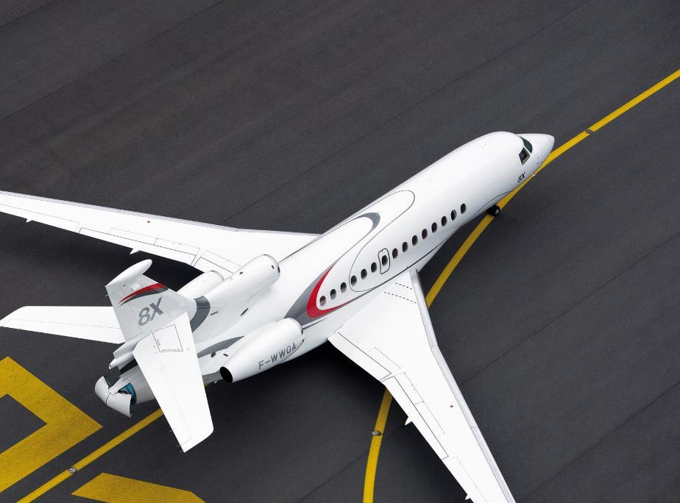
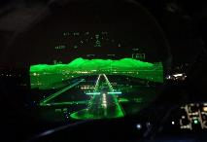
卓越的性能 Performance
双引擎或三引擎设计 Twin-engine or Three-engine
灵活性 Twin-engine or Three-engine
可靠性 Reliability
短跑道起降性能 Short field performances→视频 Video Les Eplatures
航程 Range

Slide 7
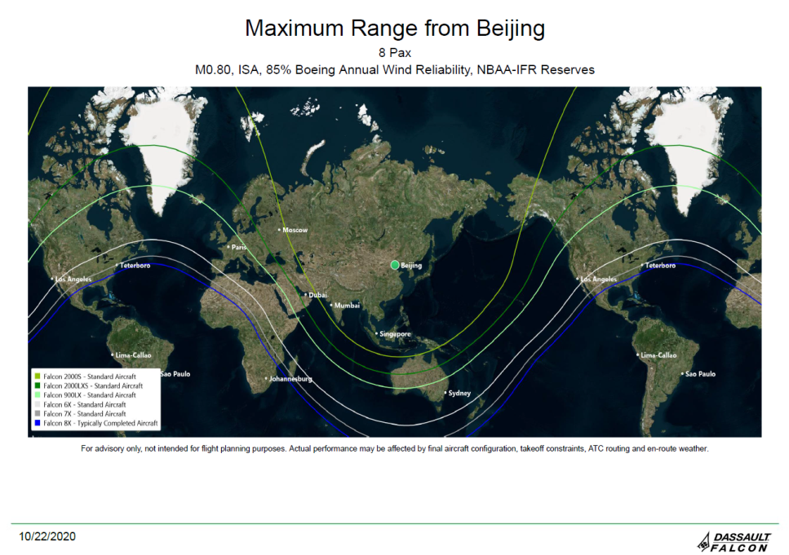
航图 Range Map
从北京出发的最大航程
8名乘客，0.80马赫，国际标准大气压，85%波音年度风可靠性，NBAA-IFR燃油储备

Slide 8
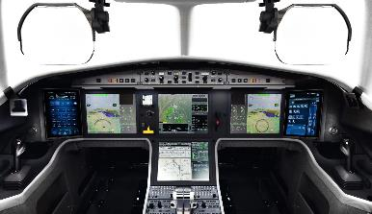
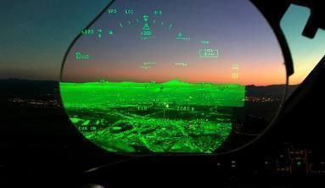
运行安全 Operational Safety
业内视野最宽阔的平视显示器（HUD）
The Head-Up Display (HUD) in any business aircraft
多光谱融合的新型摄像头（6 个传感器），最大化地突破天气对视野的阻碍，最大化情景感知和 LED 探测
New camera with multispectral fusion (6 sensors) for maximum weather penetration, situational awareness and LEDs detection
猎鹰之眼（FalconEye） - 视景结合系统（CVS）和增强视景系统（EVS）的独特组合
FalconEye - Combination of Enhanced Vision System & Synthetic Vision System
视景结合系统（CVS）实时地整合了合成视景系统 (SVS)、数据库驱动地形描绘，和带有热成像低光摄像图的增强视景系统 (EVS)。即使遇到能见度低或极差的情况，它也能为飞行员提供前所未有的情景感知能力，确保无可比拟的安全性。
Providing an unprecedented level of situational awareness in low-and poor- visibility conditions, during all phases of flight allowing you to land up to 100 feet of low visibility.
No need of CAT III airport compliances
→视频 Video CVS

Slide 9
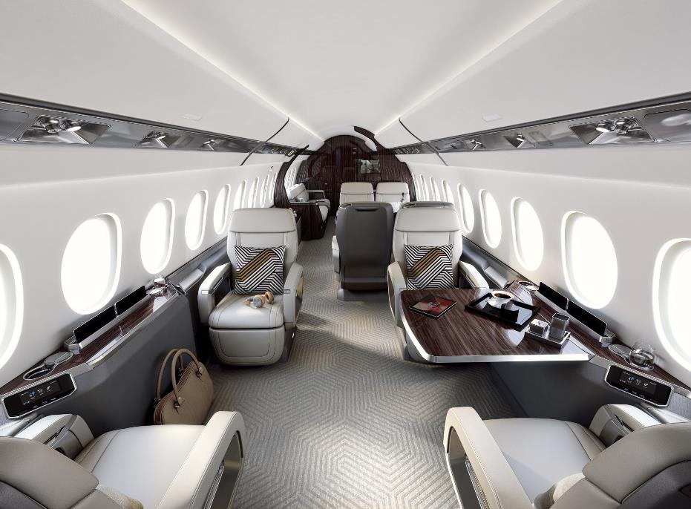
内饰与客舱 Interiors and Cabin

Slide 10
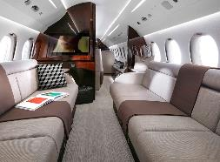
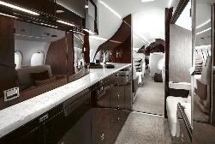
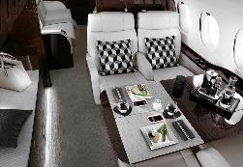
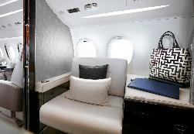
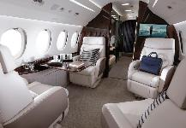
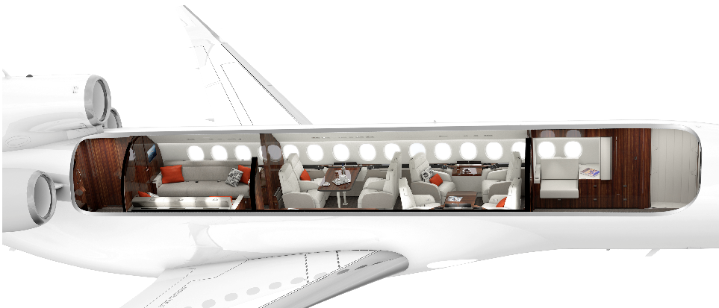
舒适的客舱
Comfortable Cabin

Slide 11
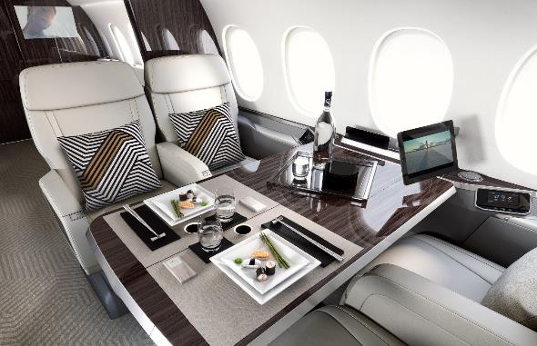
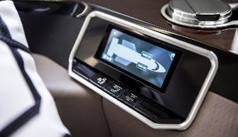

客舱配置 Cabin connectivity
先进的互联通信：Advanced connectivity:
无线网连接高速网络 High speed internet with Wi-Fi connectivity
无线连接：手机，笔记本电脑……Wireless connectivity: smartphones, laptops, tablets…
全高清音频和视频系统：Full High Definition of Audio and Video system:
全高清彩色监控 Full HD color monitors
扩大器，扬声器，低音炮 Amplifier, speakers, and subwoofers
电动座椅和舷窗遮光板 Electrical seats and window shades
定制配件：Customized components:
多种语言控制面板 Control panels in multi-language
3D 互动航图 Airshow with 3D interactive map
客舱灯光调节 Moonlight cabin environment
USB接口，标准插头，无线充电 Recharging devices with USB, Standard plugs or wireless

Slide 12
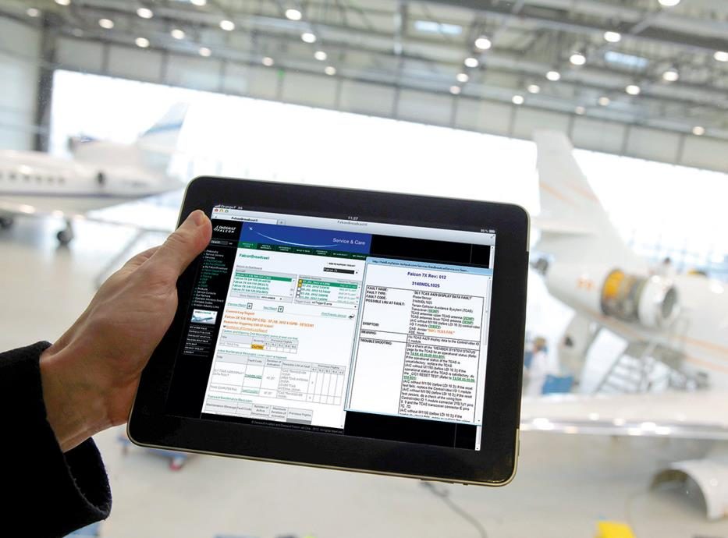
客户服务 Customer Service

Slide 13
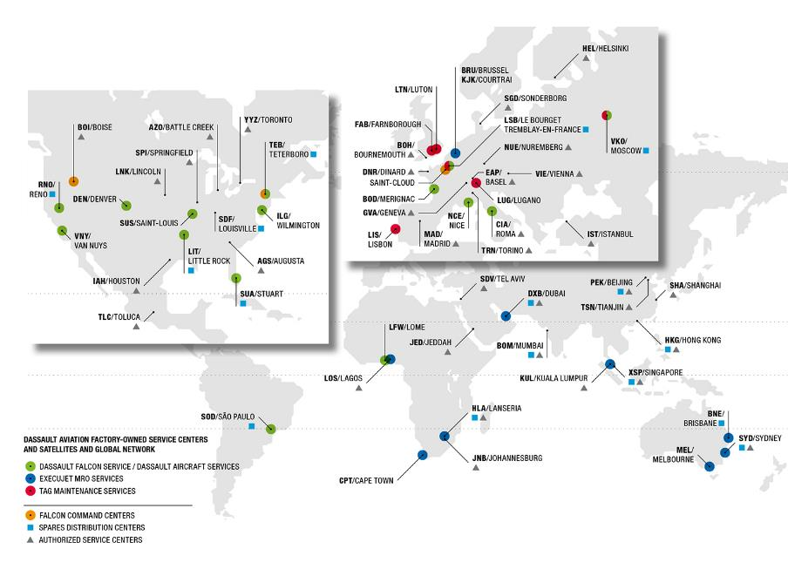
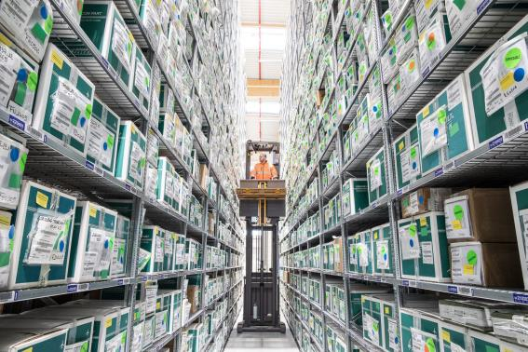
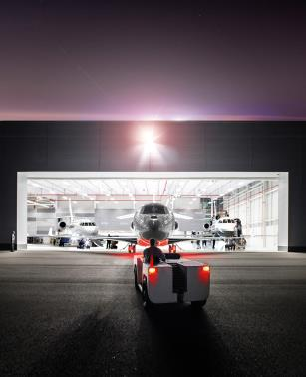
全球网络&机构组织 Worldwide Network & Organization
零部件中心网络
Spare Parts Center Network
&
授权中心网络
Authorized Center Network

Slide 14
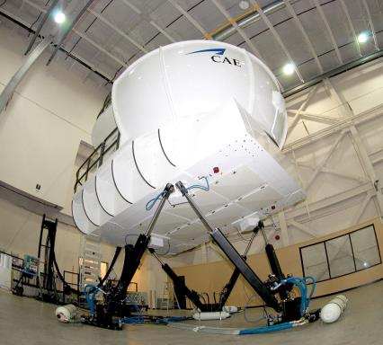
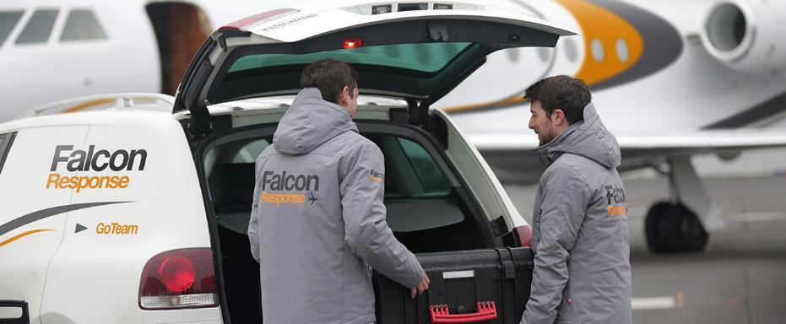
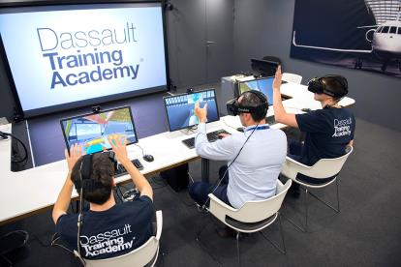
全球网络 Worldwide Network
培训网络
Training Network
&
技术人员网络
Techniciens Networks

Slide 15
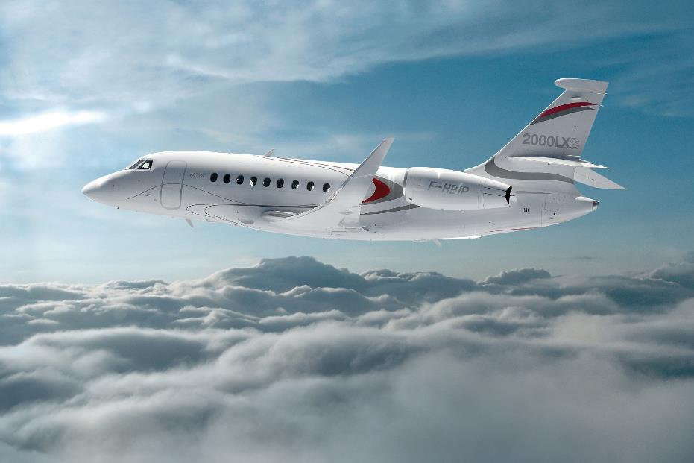
感谢倾听
THANK YOU

